Slide 1

Using DNA Sequencing To Diagnose Single Gene Disorders
Alan Pittman, PhD
Lecturer in Bioinformatics
Fundamentals of Human Genetics 2019

Slide 2
Evolution of Sequencing Technologies
PCR
Fragment Analysis
Sanger Sequencing
Next-generation sequencing
Whole genome sequencing
Whole exome sequencing

Slide 3
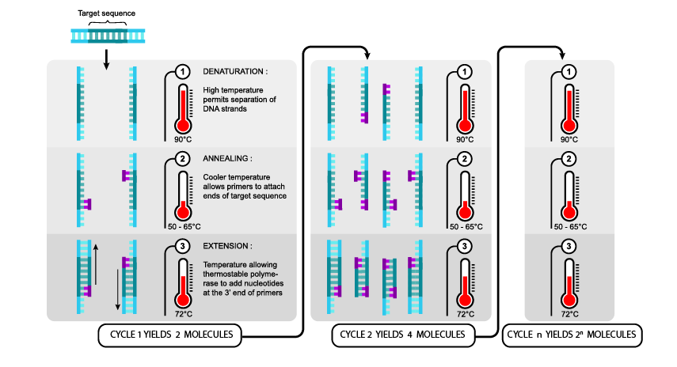
Polymerase Chain Reaction(PCR)
Fundamental for any DNA sequencing application
PCR is used to amplify a specific region of DNA; primers flank the region you want to amplify.
Each cycle doubles the amount of DNA copies of your target sequence
Amplify enough DNA molecules so that we have sufficient material to sequence or for other applications
3 step process
https://www.shmoop.com/dna/pcr-polymerase-chain-reaction.html

Slide 4
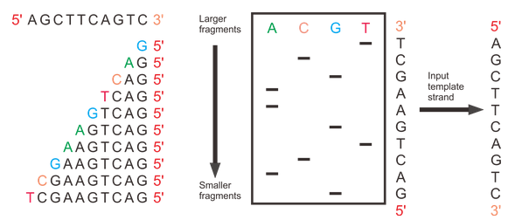
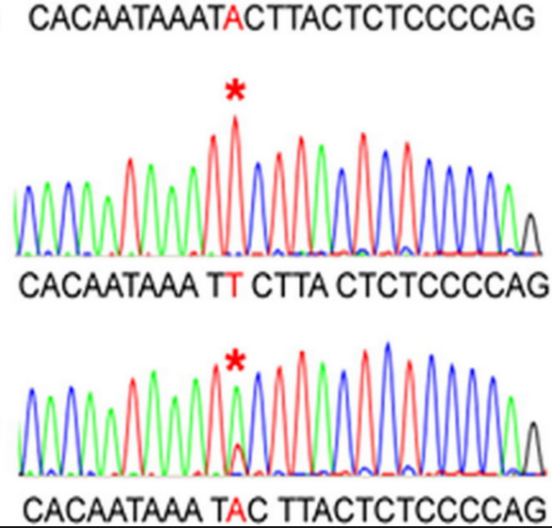
Sanger Sequencing
Invented by Fred Sanger in 1977
Cycle Sequencing
One reaction = one sequence
Up to 800 bp per reaction
Accurate (99.99%)
Slow and low-throughput
Used predominantly until late 2000s
Costly ££££
https://zhonglab.gitbook.io/3dgenome/chap0-preparation/0.2-sequencing-technologies
http://en.wikipedia.org/wiki/DNA_sequencing
Capillary Electrophoresis

Slide 5
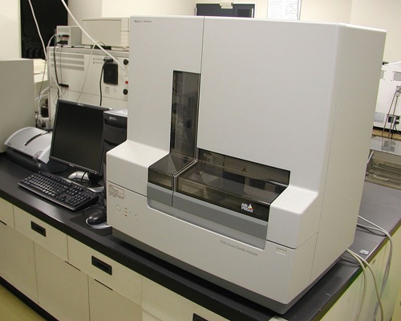
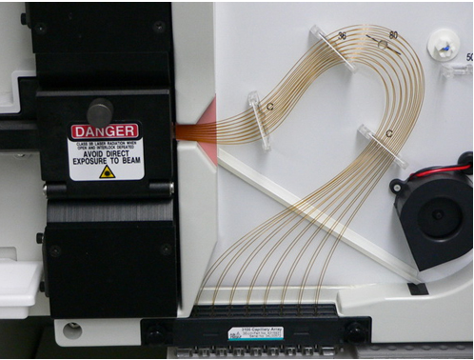
Sanger Sequencing

Slide 6

Sanger Sequencing
Identify single nucleotide polymorphisms (SNPs), or mutations
We can identify monogenic disease causing mutations
Usually for single gene tests
E.g. CTFR in cystic fibrosis

Slide 7
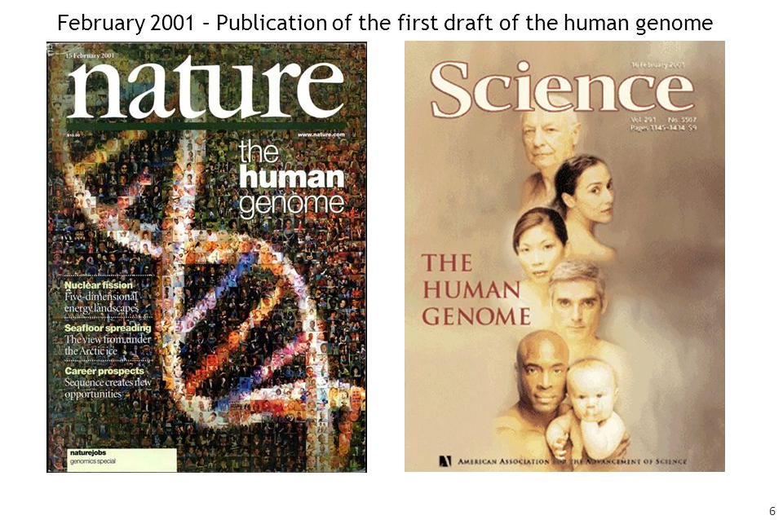
The Human Genome Project
Human Genome Project (1990 - 2003)
3 billion base pairs long
All done with traditional Sanger Sequencing
Unravelled the first Human Genome Sequence to drive genetics research
We can now achieve this amount of sequencing in as little time as one day!

Slide 8
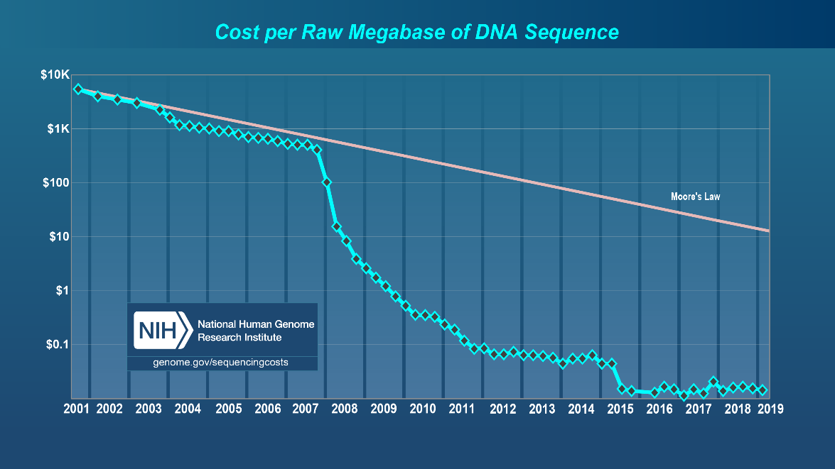
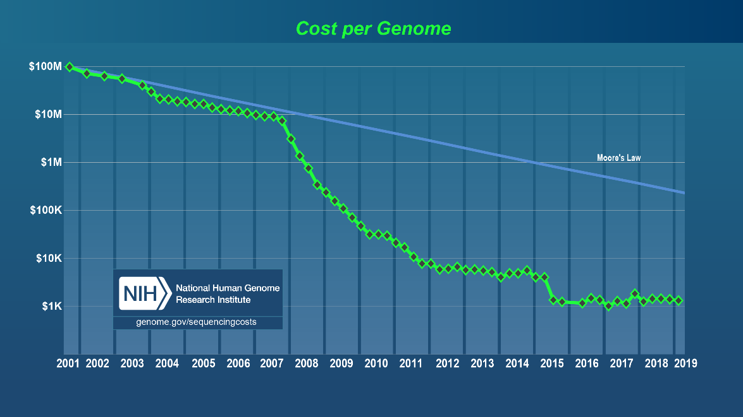
The Next Generation of Sequencing
Technological advances leading to a decrease in the cost of DNA sequencing
Since the end of 2007, the cost has dropped at a rate faster than that of Moore’s law
https://www.genome.gov/about-genomics/fact-sheets/DNA-Sequencing-Costs-Data

Slide 9
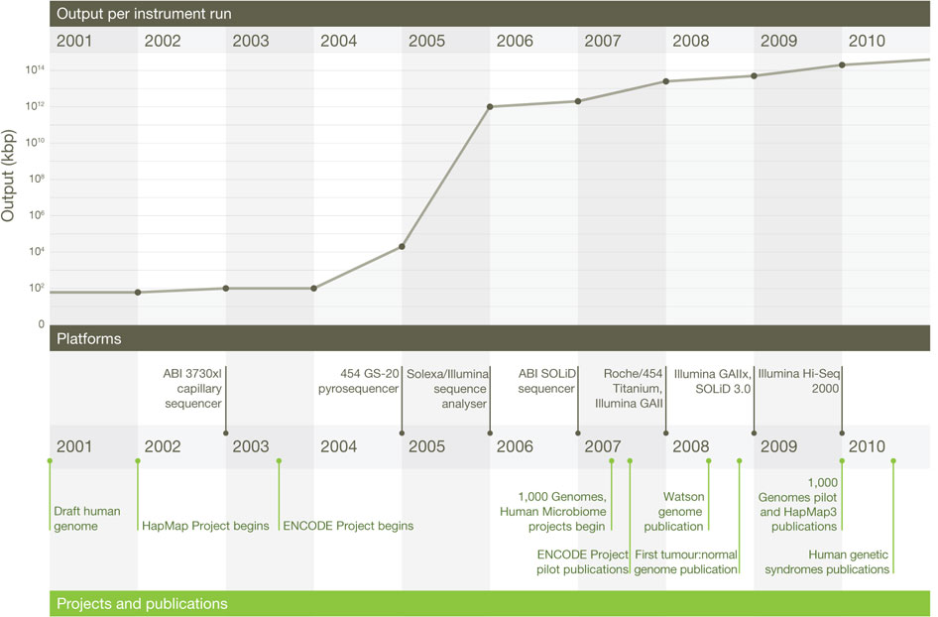
The Next Generation of Sequencing
Development of new NGS methods began in 2014 with 454 pyrosequencing
Solexa/Illumina developed in 2005
DNA sequencing throughput jumped 10 orders of magnitude
Market is now (STILL) dominated by Illumina SBS sequencing
A decades perspective on DNA sequencing technology.
Elaine R. Mardis et al. Nature 470, 198–203 (10 February 2011)

Slide 10
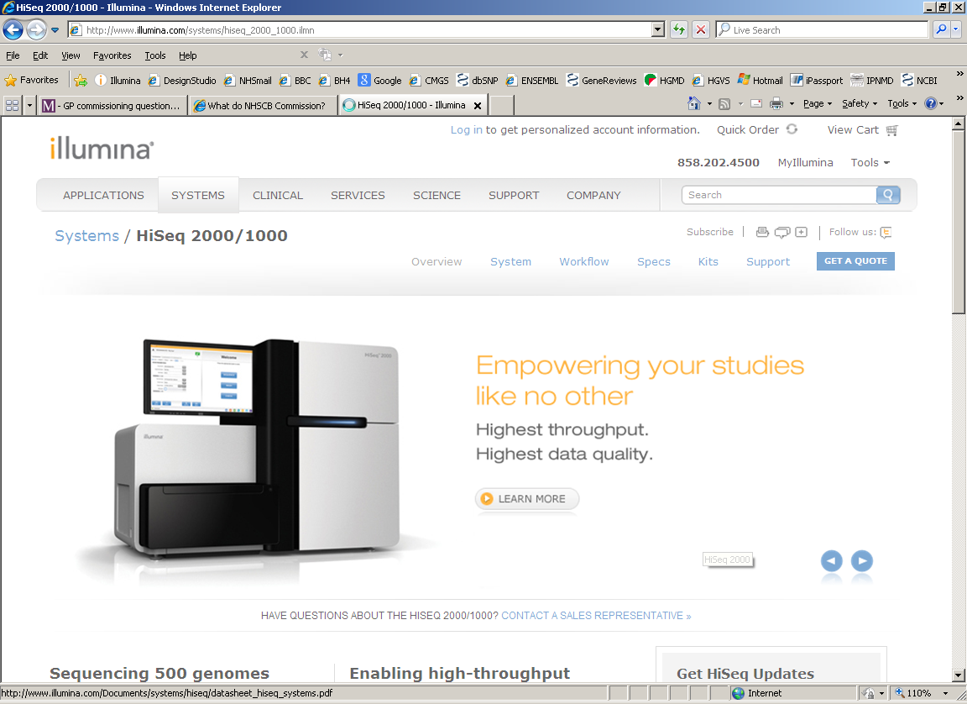
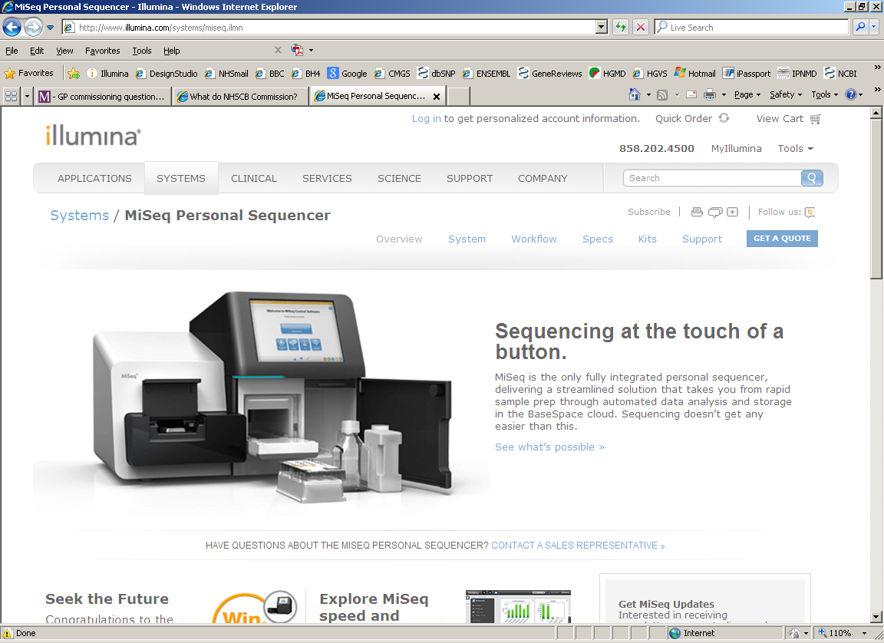
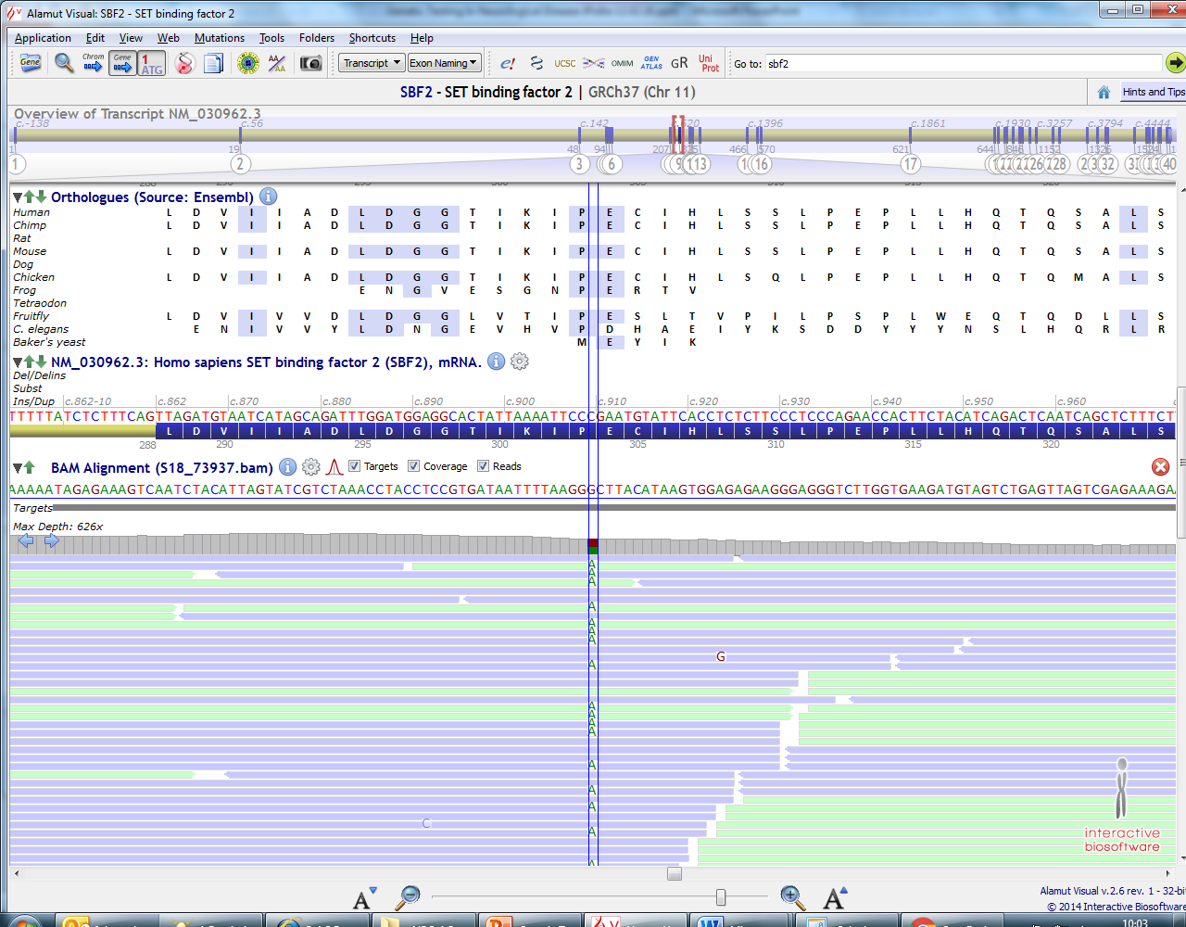
Next Generation Sequencing
Next Generation Sequencing has replaced Sanger sequencing for almost all sequencing tests in the lab

Slide 11
Next Generation Sequencing
An end to sequential testing with Sanger sequencing
Wider range of tests in a shorter time for less money
Current strategy: Disease panels
Enriching to sequence only the known disease genes relevant to the phenotype
Panels expandable to include new genes as they are published
“Exome” – more on this later
Pathogenic variants (still) confirmed by Sanger sequencing

Slide 12
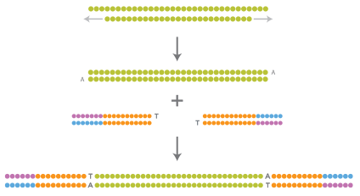
Whole-Genome Sequencing I
Step 1: DNA library construction
In the wet lab – prepare the DNA sample for sequencing
Essentially the DNA is broken down into small fragment (300bp)
Adapters are added on the end of the fragments
Adapters contain essential components to allow the fragments for sequencing
The sample DNA library is now ready for sequencing
Sheared Sample DNA fragments
End - Repair
A-tailing
Adapter ligation
DNA library
www.Illumina.com

Slide 13
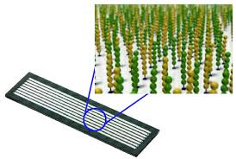
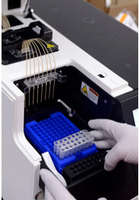
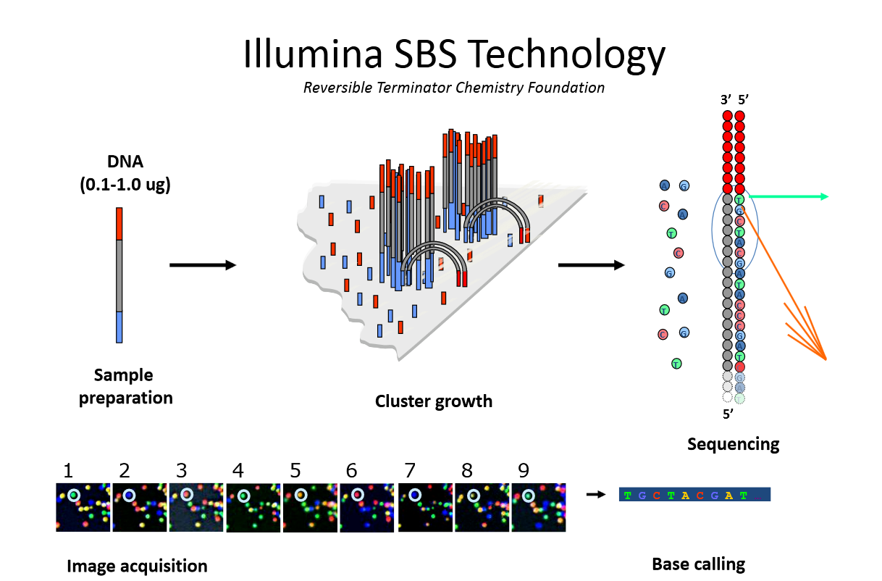
Whole-Genome Sequencing II
Step 2: cluster generation
Hybridise DNA library to the flowcell
Perform bridge PCR to generate clusters
Flow cell is now ready to be loaded on to the sequencer to perform the sequencing
Massively parallel
Flowcell
cBOT
Bridge PCR

Slide 14
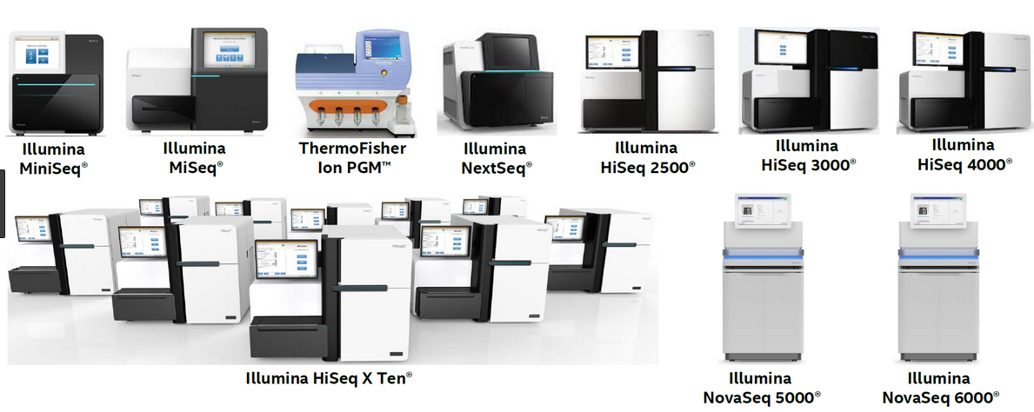
Illumina Sequencers

Slide 15
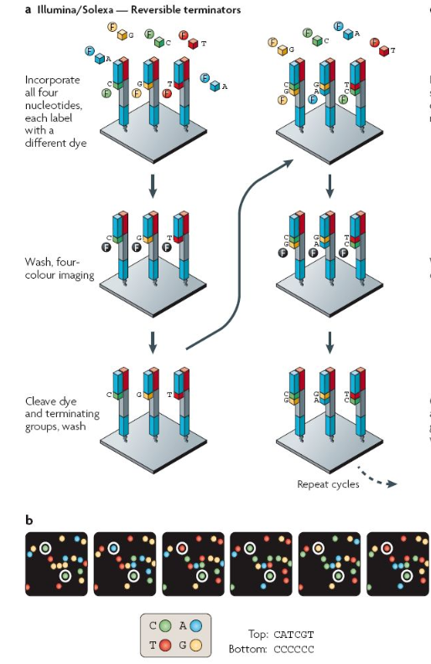
Whole-Genome Sequencing IIIa
Step 3: sequencing-by-synthesis
Annealing of sequencing primer
Sequence each nucleotide 1 cycle at a time in a controlled manner
Modified 4 bases (ATCG) with chain terminators AND a different fluorescent colour dye

Slide 16
Whole-Genome Sequencing IIIb
Single nucleotide incorporation (DNA polymerase)
Flowcell wash
Image the 4 bases (digital photograph)
Cleave chain terminator chemical group and dye with enzyme
Repeat (n) times for full length sequence
https://www.youtube.com/watch?v=fCd6B5HRaZ8

Slide 17
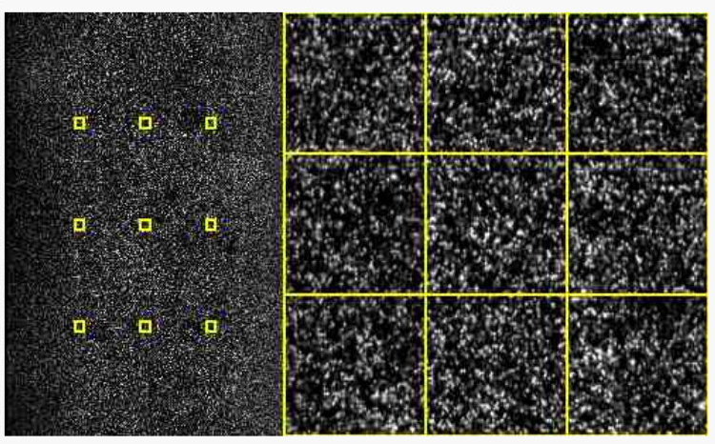
Whole-Genome Sequencing IIIc
Camera sequentially images all 4 bases on the surface of the flowcell each cycle
Each cycle image is converted to a nucleotide base call (A or C or G or T)
Cycle number anywhere between 50 – 250 nucleotide base pairs, depending on desired sequence length
(https://www.youtube.com/watch?v=fCd6B5HRaZ8)

Slide 18
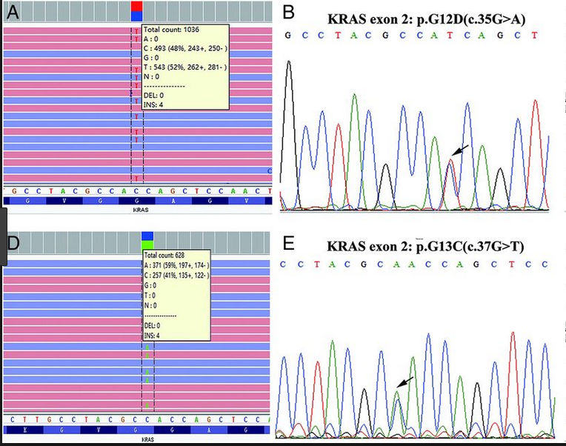
NGS v Sanger Sequencing
NGS (left) produces a digital readout. Sanger (right) produces an analogue readout
Sanger is one sequence read
NGS is a consensus sequence of many reads

Slide 19
Analysis of Next-Generation Sequencing Data

Slide 20
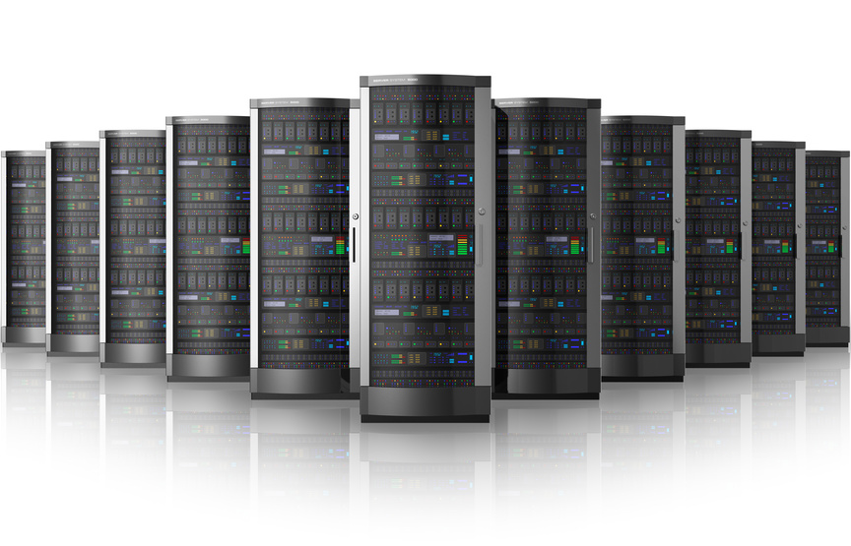

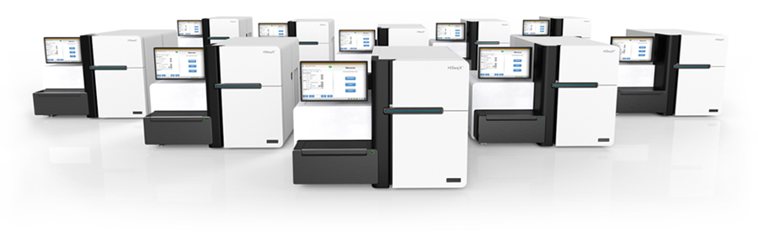
Genome Sequencing Is Not Trivial
Interpretation of clinical exomes and genomes is currently has a substantial manual component
Data generation
Data processing and automated interpretation
Manual interpretation
Total time
Hands on time

Slide 21
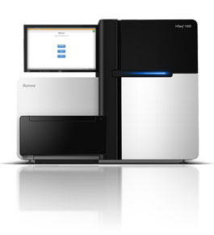
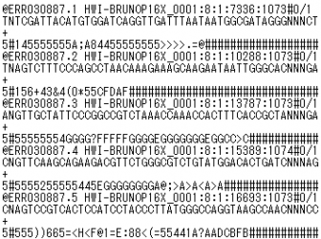
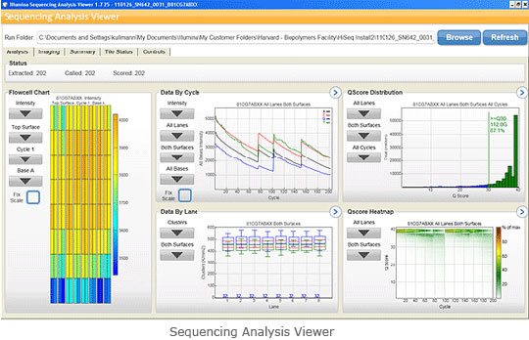
Whole-Genome Sequencing Data
Machine DNA base calls
Short read sequences representing our original DNA library

Slide 22
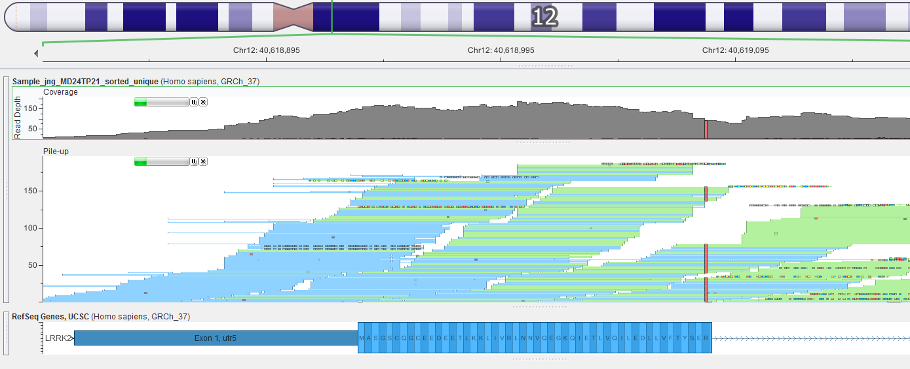
Analysis of NGS Data
Short read sequences from the machine need to be re-assembled like a jigsaw
To generate a consensus sequence of our original DNA samples
We can compare this consensus sequence against the human genome reference and look for the genetic variants
Dedicated software and bioinformatics tools will achieve this

Slide 23
NGS Data Analysis
How is NGS data analysed?
NGS Data analysis represents the real challenge (and fun part!)
There are 4 steps:
1) Primary Analysis (process the machine raw data)
2) Secondary Analysis (align the short read sequences to
the genome)
3) Tertiary Analysis (call variants in the sequence data)
4) Quaternary Analysis (interpret the genetic data)

Slide 24
Process raw sequence data (Primary Analysis)
Standard fastq file:
Four lines per short read sequence:
1) Sequence ID
2) Nucleotide Sequence
3) Strand
4) Per base quality score
Machine DNA base calls
Generate sequence files
http://www.Illumina.com

Slide 25
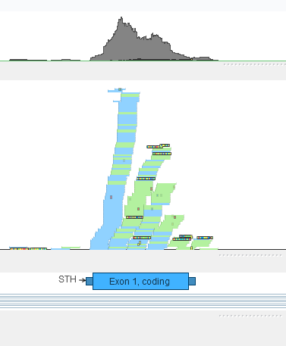
Alignment to the Genome (Secondary analysis)
Align short sequence reads (the fastq files) to the reference genome
Specialist alignment programs; BWA,
Generates a .bam
Alignment file
Short-read sequences
(Fastq format)
generate overlapping sequence contig
Aligning to genome reference
http://www.goldenhelix.com/GenomeBrowse/

Slide 26
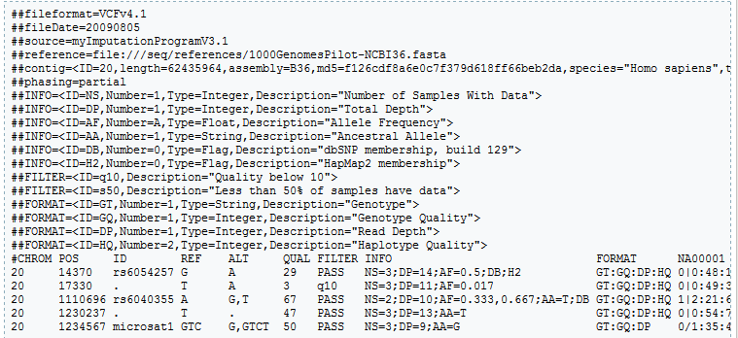
Variant Detection (Tertiary Analysis)
Look for differences in the aligned data compared to that of the reference genome
Specialist programs : SAMTOOLS, GATK
DNA Variant
http://www.goldenhelix.com/GenomeBrowse/
End result of variant detection is a table of variants found in the sequenced DNA sample
Standard variant call (.vcf) format
http://www.1000genomes.org/

Slide 27
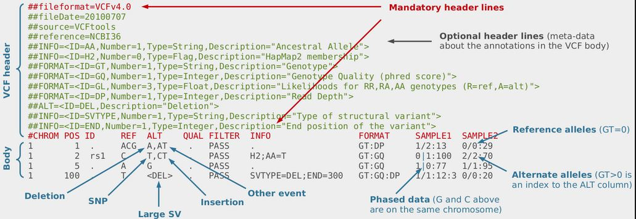
Variant Detection (Tertiary Analysis)
http://www.1000genomes.org/
End result of variant detection is a table of variants found in the sequenced DNA sample
Standard variant call (.vcf) format

Slide 28
Making sense of the variant data (Quaternary Analysis)
We need to interpret the variant data
Typically there are 3 million variants detected in any given human genome
We can detect 23,000 variants in an ‘exome’
What does all this genetic variation mean?
Variant
frequency
information
Publically
available databases
GENE
information
Variant Data
(.vcf file)
Annotated variant
data for interpretation
Annotation software

Slide 29
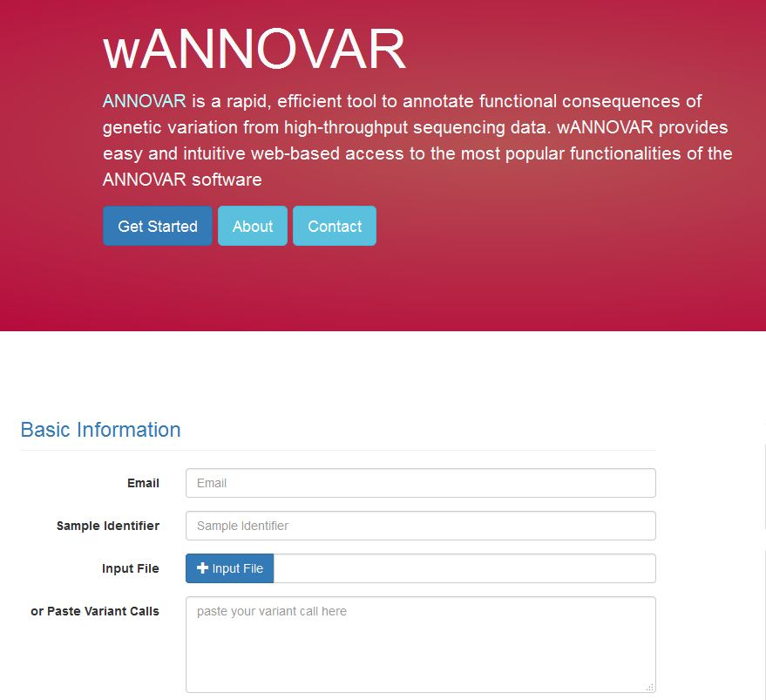
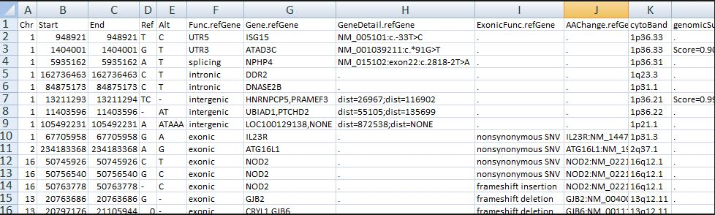
Making sense of the variant data (Quaternary Analysis)
Annovar variant annotation software
Most widely used
Gene detail/consequences/freq data
http://wannovar.wglab.org/

Slide 30
Summary II
Over the past 10 years the cost of DNA sequencing has dropped several orders of magnitude
This is due to technological advances
Principles of whole-genome sequencing
How we analyse genome sequencing data

Slide 31
Using Next Generation Sequencing To Diagnose Single Gene Disorders

Slide 32
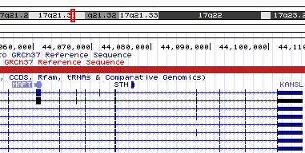
Exome Sequencing I
There are ~21,000 genes in the human genome
Often we are only interested in the gene protein coding exons or ‘exome’ represents 1-2% of the genome
Some ~80% pathogenic mutations are protein coding
More efficient to only sequence the bits we are interested in, rather than the entire genome
Costs £1,000 for a genome, but only £200-£300 for an exome

Slide 33
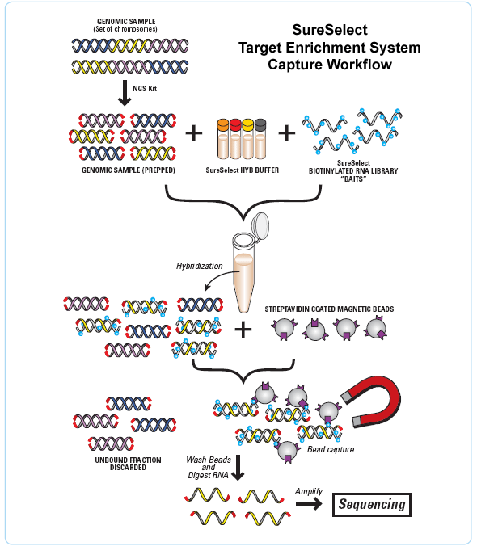
Exome Sequencing II
Target enrichment
Capture target regions of interest with baits
Potential to capture several Mb genomic regions (typically 30-60 Mb

Slide 34
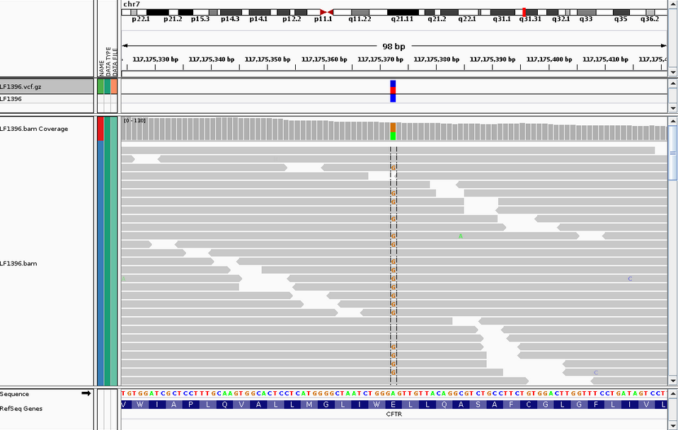
Exome Sequencing III
Patient DNA sample subjected to exome sequencing
Zoom in on the gene/exon of interest
Example on the right shows a snippet of the consensus sequence of that sample
Reveals a heterozygous mutation in the CFTR gene

Slide 35
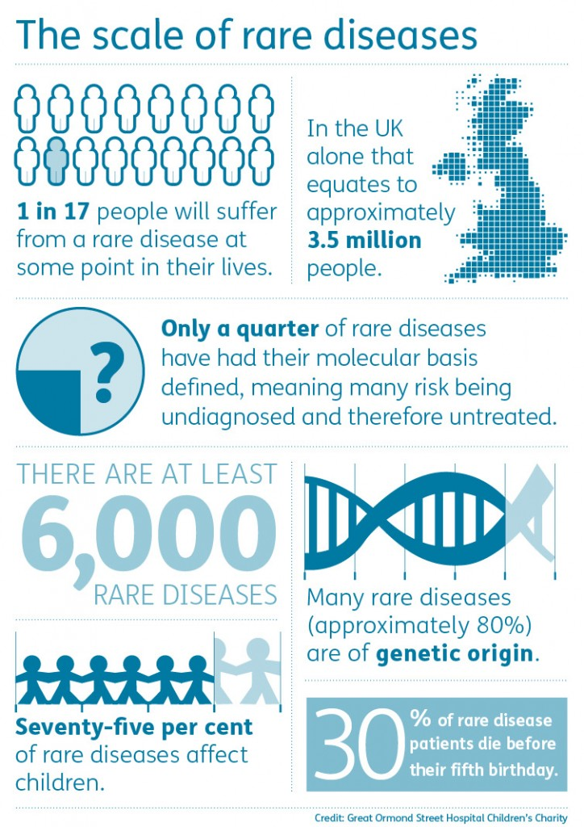
What is a rare disease ?
Defined by the EU as one that affects less than 5 in 10,000
There are between 6,000 and 8,000 known rare diseases; and around 5 new diseases are described in the medical literature each week.
1 in 17 people will be affected by a rare disease (3.5 million people in the UK)
Often chronic and life threatening
80% of rare diseases will have a genetic component

Slide 36
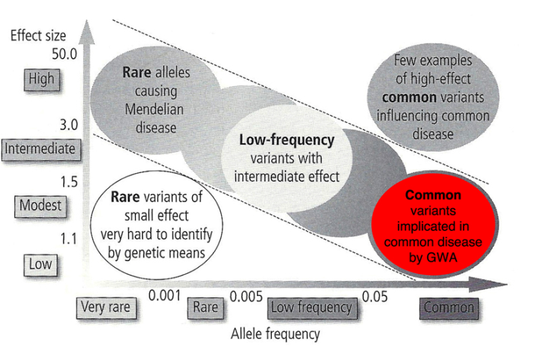
Genetics of Rare Diseases
It’s all about finding answers !
We are looking for rare mutations that may underline the disease
Many genetic diseases are well understood
Others have unknown genetic causes
Diagnosis is very difficult
Next generation sequencing can give us a quick answer!

Slide 37
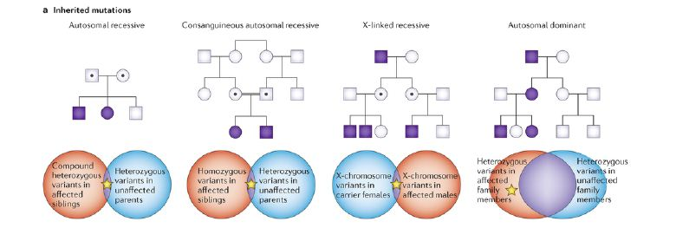
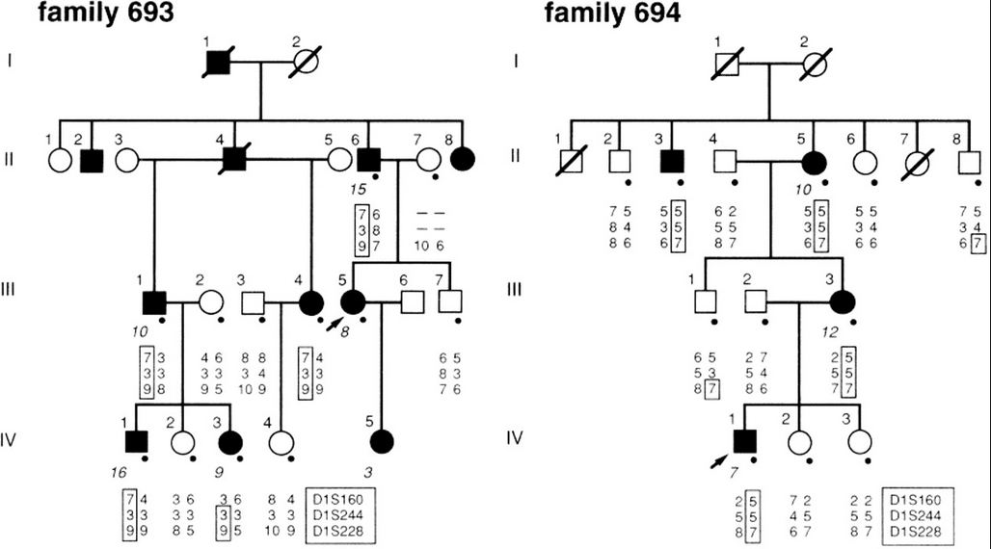
Diagnosing Rare-Diseases With NGS
Collecting disease affected individuals and their families
Incorporation of next-generation sequencing into traditional genetics
Look for rare mutations shared between affected individuals
Segregation of mutation in families / affected individuals

Slide 38
Interpreting Results
How to establish if a mutation is pathogenic?
Quaternary analysis – look at annotated variant data
Reported in ExAC (dbSNP / 1000 Genomes / NHLBI)?
How common?
Look at sub-populations
Previously published:
Read the papers!
Segregation
Controls (which population?)
Functional studies
Mode of inheritance
Locus-specific databases of published and unpublished data
Nonsense, frameshift, splice site (exon+/-2 bp)
Missense/intronic mutation
In-silico tools for missense and splicing mutations
Never considered in isolation

Slide 39
Genetic Test Outcomes
Pathogenic mutation
Normal variation
Polymorphism
Novel variant / variant of unknown significance
Investigations to establish significance

Slide 40
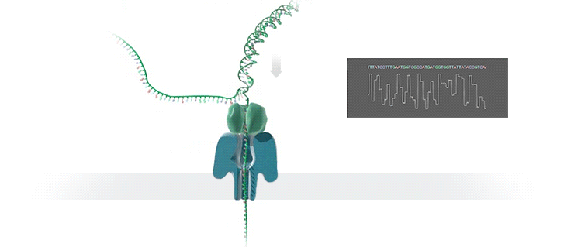
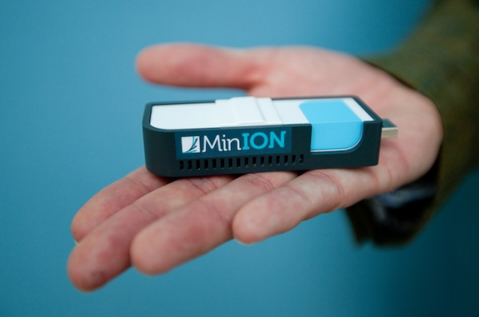
Just for fun..
Oxford Nanopore sequencing
Single-molecule sequencing
No PCR involved
DNA passes through a nanopore and base sequence is converted into an electrical current

Slide 41
Thank You ?
Alan Pittman, PhD
Lecturer in Bioinformatics
apittman@sgul.ac.uk

